Slide 1
SPORTS ANALYSIS

Slide 2
INTRODUCTION
Project Overview:
The objective is to assess cricket player fitness and performance for an upcoming T20 game.
Data sourced from 12 Excel files with JSON-formatted raw data.
Implemented a meticulous cleaning process in Jupyter Notebook for robust analysis.
Visualized key insights through an interactive dashboard created in Tableau.

Slide 3
DATA CLEANING PROCESS
Steps in Jupyter Notebook:
JSON to DataFrame: Transformed raw JSON format into a structured DataFrame.
Data Cleaning: Removed irrelevant data and handled null values systematically.
Concatenation: Merged individual DataFrames into a consolidated dataset.
Excel Export: Converted the unified DataFrame into an Excel file for accessibility.

Slide 4
TABLEAU DASHBOARD

Slide 5
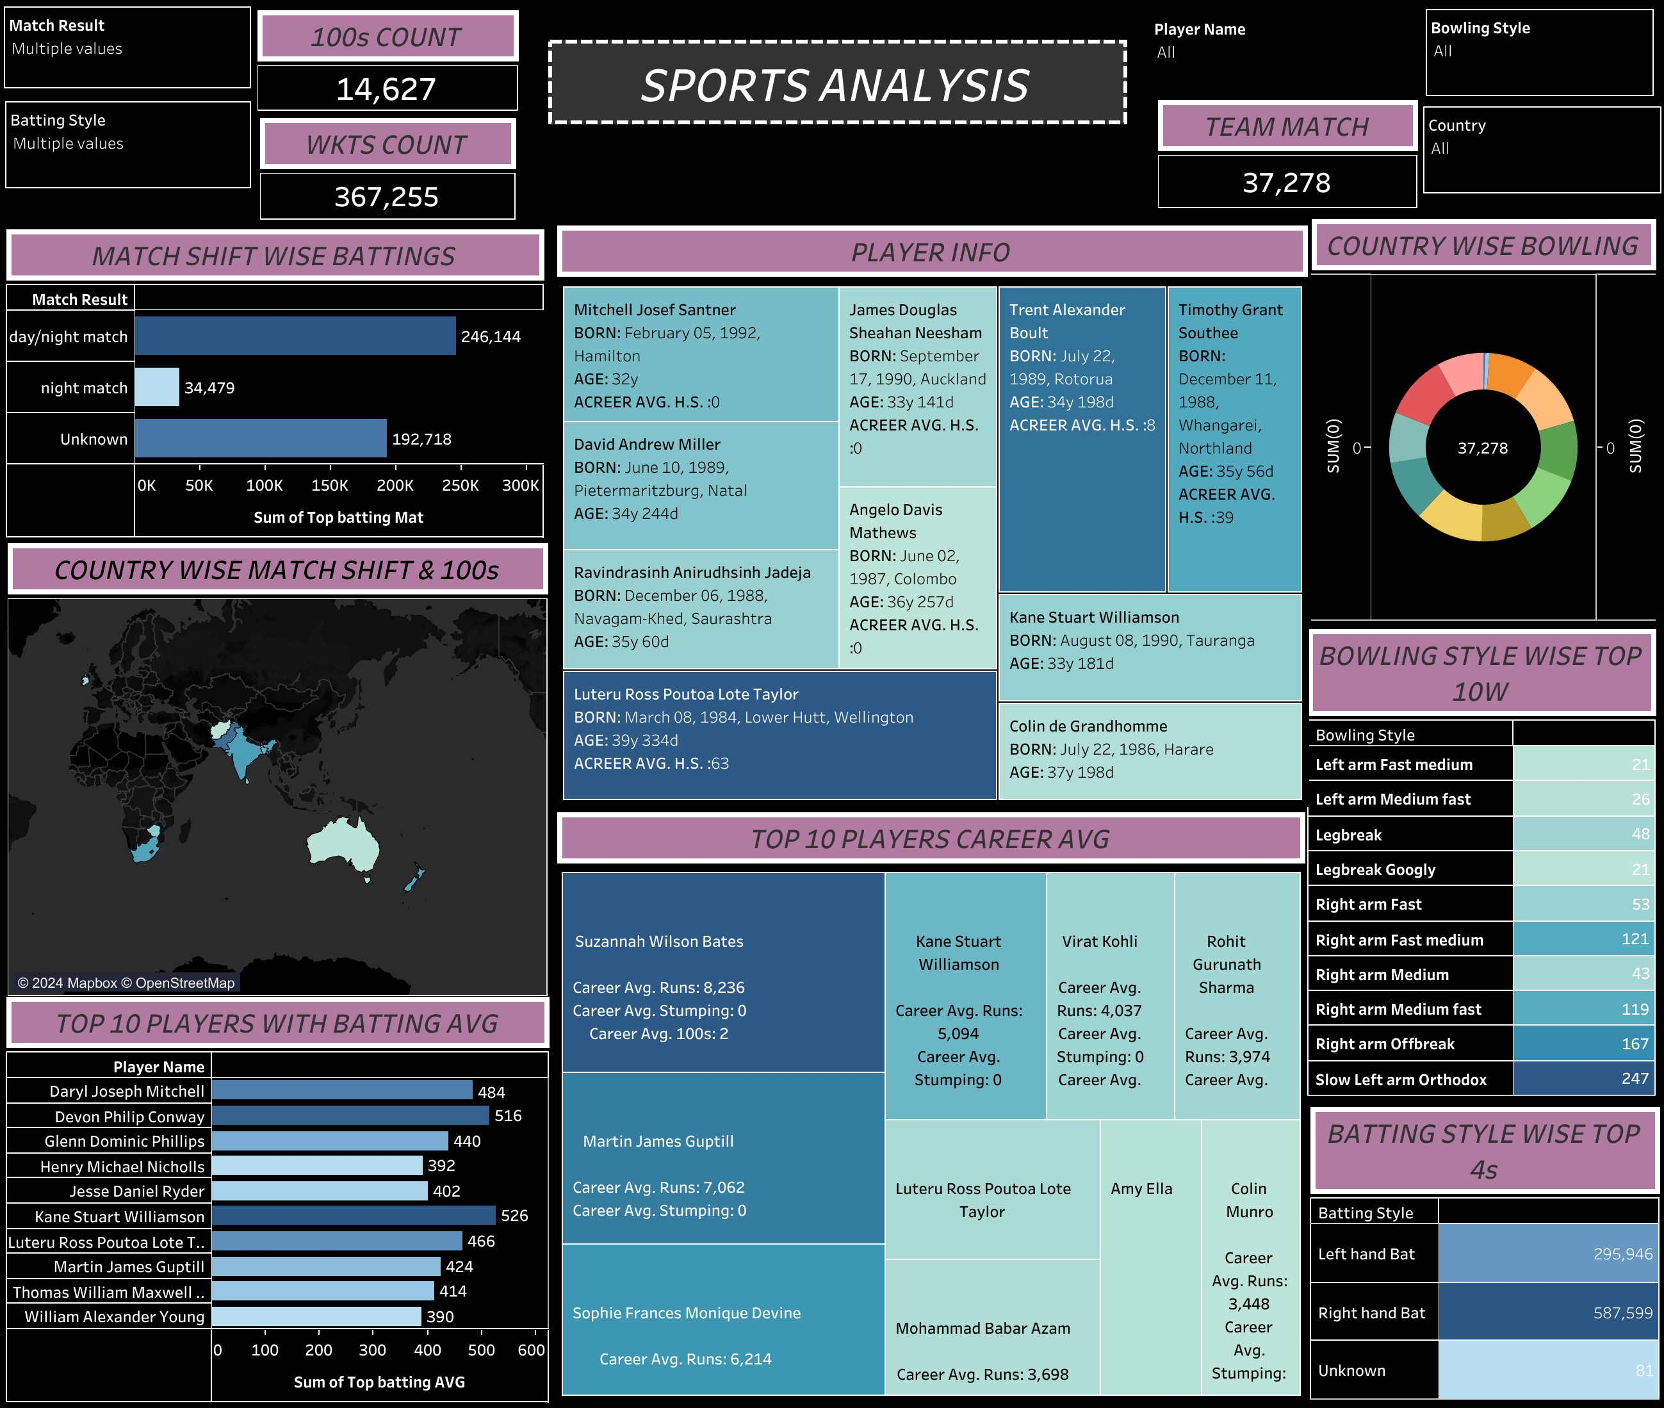

Slide 6
BAR CHART - TOP 10 PLAYERS WITH BATTING AVG:
Enables quick identification of top-performing players by showcasing their batting averages.
Hover over the bars to reveal player names and corresponding batting averages.

Slide 7
HIGHLIGHT TABLE - BATTING STYLE WISE TOP 4S:
Highlights the batting style and sums up the top 4s for each playing style.
User-friendly overlap feature for seamless exploration.

Slide 8
GEOGRAPHIC CHART - COUNTRY WISE MATCH SHIFT & 100S:
Displays the correlation between a country's match shift and the number of centuries scored.
Hover over data points for precise information on country name, match shift, and total centuries.

Slide 9
PIE CHART - COUNTRY WISE BOWLING:
Offers a visual representation of bowling performance by country.
User-friendly overlap feature provides details on the top bowling type, country, and wickets taken.

Slide 10
HIGHLIGHT TABLE - BOWLING STYLE WISE TOP 10W:
Identifies the top bowling performers based on the number of 10-wicket hauls.
Overlap feature for detailed insights into bowling styles and achievements.

Slide 11
TREE MAP - TOP 10 PLAYERS CAREER AVG:
Visualizes the career averages of top players, including batting average, centuries, runs, catches, and stumpings.
Hoverlap feature for an in-depth view of individual player statistics.

Slide 12
BAR CHART - MATCH SHIFT WISE BATTING:
Illustrates batting performances concerning match shifts.
Overlap feature for a granular view of batting trends during different shifts.

Slide 13
TREE MAP - PLAYER INFO:
Provides a detailed overview of player information, including name, birthdate, age, and total not-outs.
Overlap feature for convenient exploration of player details.

Slide 14
COUNT VALUES:
Displays total centuries, total wickets, and total team matches.
Interactive filters for a customized exploration experience.

Slide 15
CONCLUSION:
Key Takeaways:
The analysis offers comprehensive insights into player fitness and performance.
Informed decisions for player selection and strategic planning for the upcoming T20 game.
The interactive Tableau dashboard provides a user-friendly platform for data exploration.
Filter options enhance customization, allowing for dynamic analysis.

Slide 16


